Slide 1
Online Bike Rental System
Md Noorullah Khan

Slide 2
Content
INTRODUCTION
PROBLEM STATEMENT
OBJECTIVE
STUDY OF EXISTING SYSTEM
REQUIREMENT COLLECTION
FUNCTIONAL
NON-FUNCTIONAL
FEASIBILITY STUDY
HIGH LEVEL SYSTEM DESIGN
METHODOLOGY
GANTT CHART
EXPECTED OUTCOME
REFERENCE

Slide 3
INTRODUCTION
Simple bike rental
CUSTOMERS FEEDBACK & RATINGS
Authentication & Authorization

Slide 4
Problem statement
Global presence
Bike rental services available in many countries.
Absence of a comprehensive system in Nepal.
Financial Constraints
Motorcycles are expensive products.
Rental services make riding accessible to a wider audience.

Slide 5
OBJECTIVE
To produce a web-based system that allow customer to register and reserve bike online.

Slide 6
Study of existing system
Maharjan Bikes Rental
This system offered:
Simple design webpage
Bike gallery
USD bike rental rates
Limitation:
No proper database
Some mentioned data couldnot be entered

Slide 7
Requirement Collection

Slide 8
Function requirement
User Registration and Authentication
Bike Listing and Details
Booking and Reservation
User profile Management
Admin Dashboard
Rating and Feedback

Slide 9
Non-Function requirement
User friendly UI
Security

Slide 10
FEASIBILITY STUDY
Technical feasibility
Operational Feasibility
Economic Feasibility
HTML, CSS, JavaScript, PHP, MySQL.
Requires standard desktop or laptop.
User friendly interface
Simplified modules for easy navigation.
Affordable website development.

Slide 11
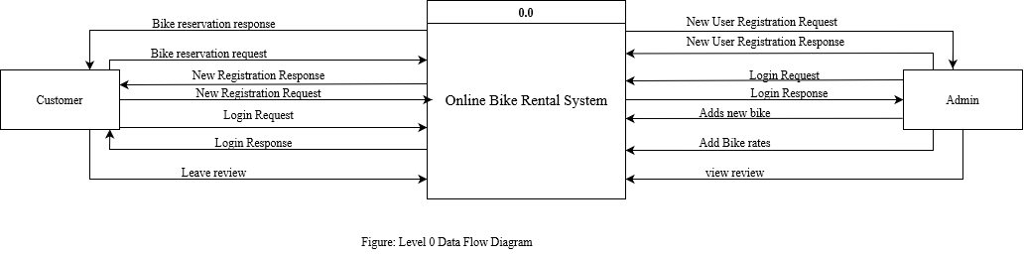
HIGH LEVEL SYSTEM DESIGN

Slide 12
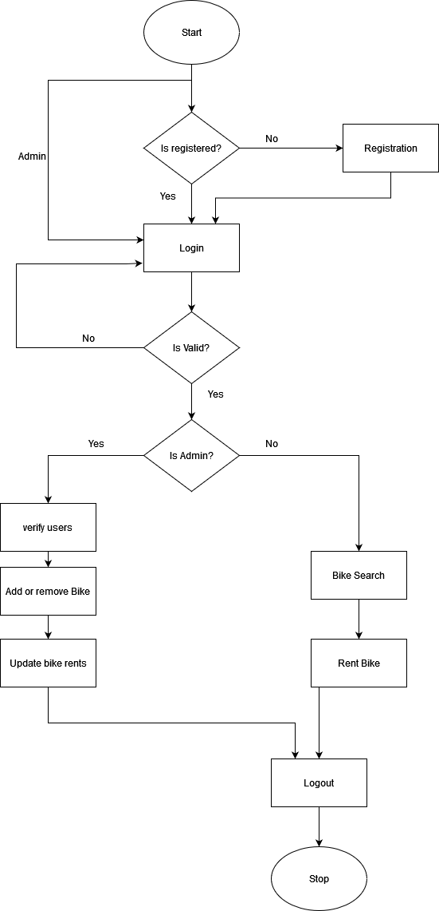

Slide 13
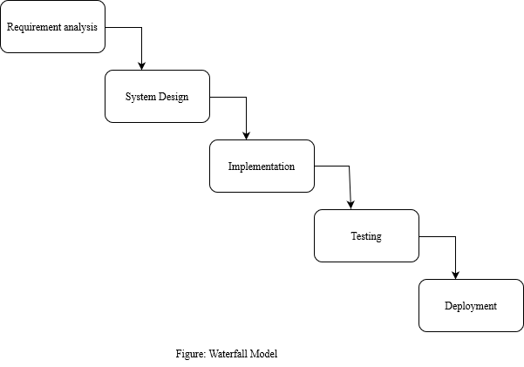
METHODOLOGY
$2B
$1B

Slide 14
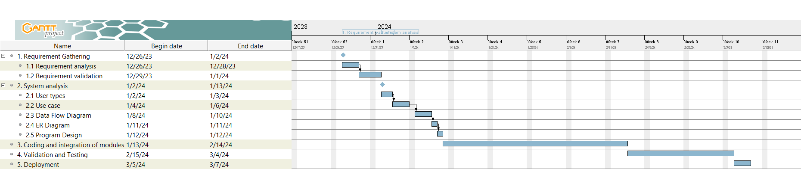
Gantt chart

Slide 15
EXPECTED OUTCOMES
A web-based system that will help you rent bikes online.

Slide 16
REFERENCES
[1] "maharjanbikesrental," [Online]. Available: https://maharjanbikesrental.com/. [Accessed 26 12 2023].
[2] "chaadride," [Online]. Available: https://chaadride.com/. [Accessed 27 12 2023].

Slide 17
THANK YOU

